Slide 1
DECISION TREE
Entropy and GINI Index
Monty Ery

Slide 2
What is a Decision Tree?
A Decision Tree is a supervised machine learning algorithm used for both classification and regression tasks. It splits the data into subsets based on the value of input features, creating a tree-like structure of decisions.
Nodes: Represent decisions or tests on features.
Edges: Represent the outcome of a decision.
Leaves: Represent the final output (class label or regression value).

Slide 3
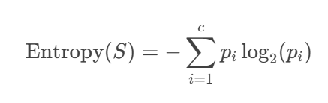
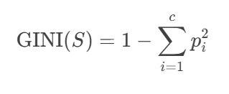
Formula:
Where:
SS: Dataset
cc: Number of classes
pipi​: Proportion of data points belonging to class ii
GINI Index
Where:
SS: Dataset
cc: Number of classes
pipi​: Proportion of data points belonging to class ii

Slide 4
Example:
Outlook | Temperature | Humidity | Windy | Play Golf
Sunny | Hot | High | No | No
Sunny | Hot | High | Yes | No
Overcast | Hot | High | No | Yes
Rainy | Mild | High | No | Yes
Rainy | Cool | Normal | No | Yes
Rainy | Cool | Normal | Yes | No
Overcast | Cool | Normal | Yes | Yes
Sunny | Mild | High | No | No
Sunny | Cool | Normal | No | Yes
Rainy | Mild | Normal | No | Yes
Sunny | Mild | Normal | Yes | Yes
Overcast | Mild | High | Yes | Yes
Overcast | Hot | Normal | No | Yes
Rainy | Mild | High | Yes | No

Slide 5
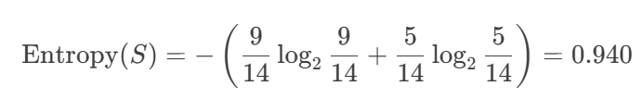
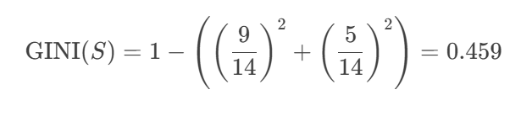
Step 1: Calculate Entropy
Total instances: 14
Play Golf: Yes (9), No (5)
Entropy:
Step 2: Calculate GINI Index
GINI:
Step 3: Split the Data
Choose the feature with the highest information gain (or lowest GINI) for splitting.
Repeat the process for each subset.

Slide 6
Step 1: Calculate Entropy
Total instances: 14
Play Golf: Yes (9), No (5)
Entropy:
Step 2: Calculate GINI Index
GINI:
Step 3: Split the Data
Choose the feature with the highest information gain (or lowest GINI) for splitting.
Repeat the process for each subset.

Slide 7
Results
Entropy Model:
Accuracy: 0.95
Precision: 0.96
Recall: 0.95
GINI Model:
Accuracy: 0.95
Precision: 0.96
Recall: 0.95

